Slide 1
Competing Human Migration Theories
Multiregional theory or 'out of africa' theory?
& Ancient Civilisations

Slide 2
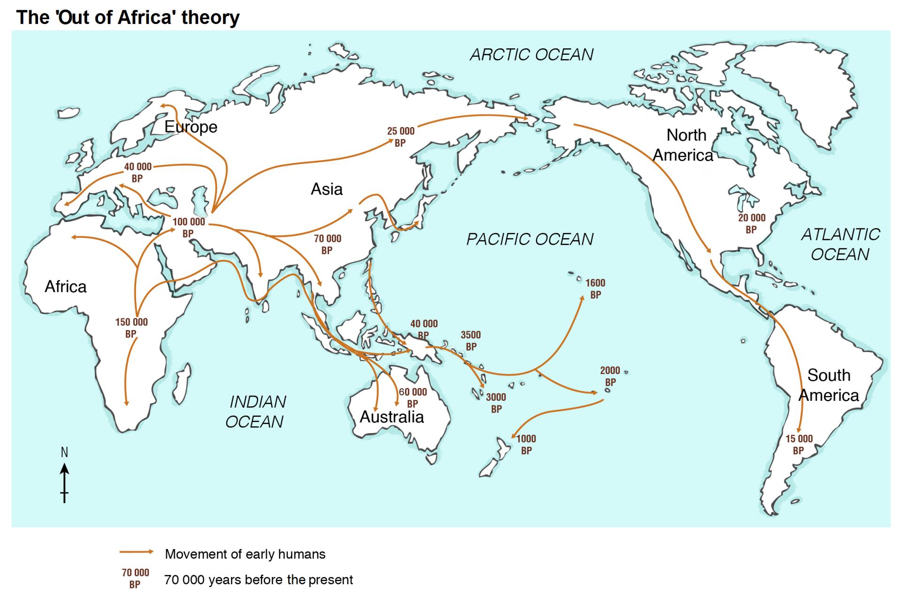
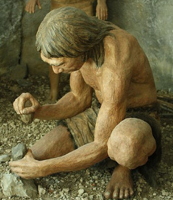
Theories of Human Migration
HINT: what do the brown numbers represent? What is circled? What does the orange arrows show?
Look at the map.
Write down everything you see.
Write down everything you think about this map.
Write down everything you wonder, what more do you want to know, what questions do you have?

Slide 3
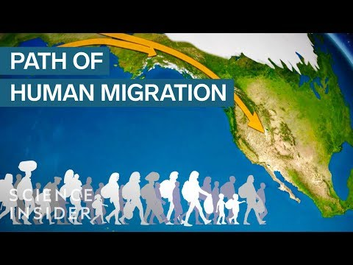

Slide 4
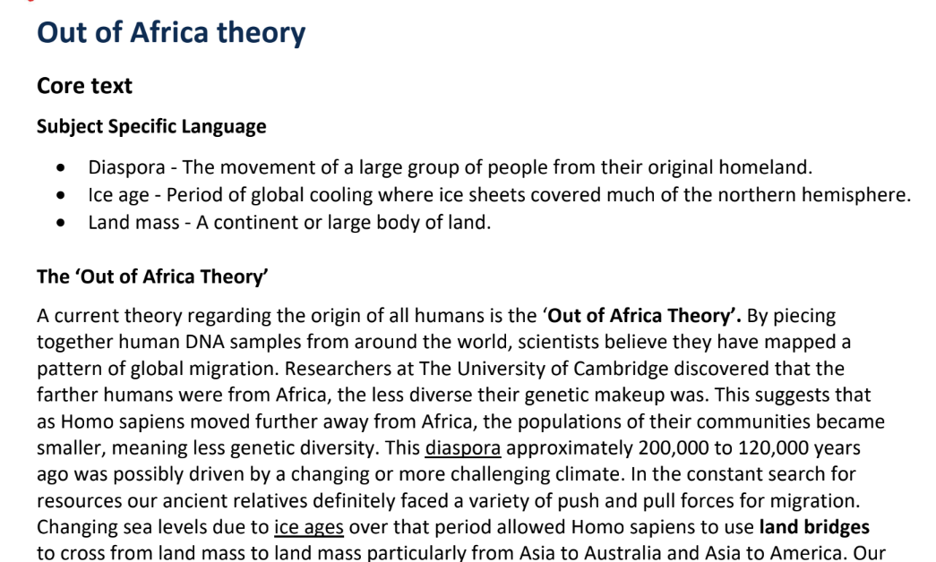
For more information about the 'Out of Africa' theory, you're welcome to click here!
How did the video confirm or conflict with what you 'see, think, wondered'?

Slide 5
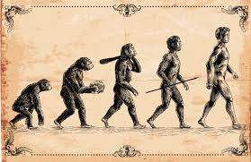
Now using Google, research what the 'Multi-regional' theory is.
How is this similar and different to the 'out of Africa' theory?

Slide 6
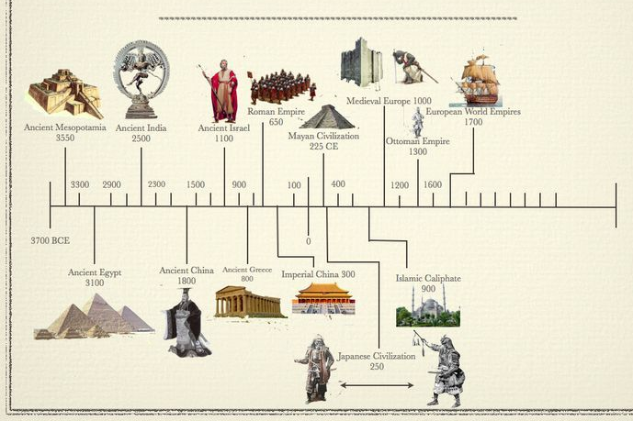
Introduction to Ancient Civilisation Timeline
Modern humans have existed on Earth for about 200,000 years. Archaeologists and scientists have gathered primary sources, such as bones and early tools, to uncover evidence about early humans, and to generate theories about how they spread across the earth. The earliest remains of people that are anatomically similar to modern humans were found in Africa. Some of the most significant ancient civilisations were ancient Egypt, ancient Greece, ancient Rome, ancient India and ancient China.

Slide 7
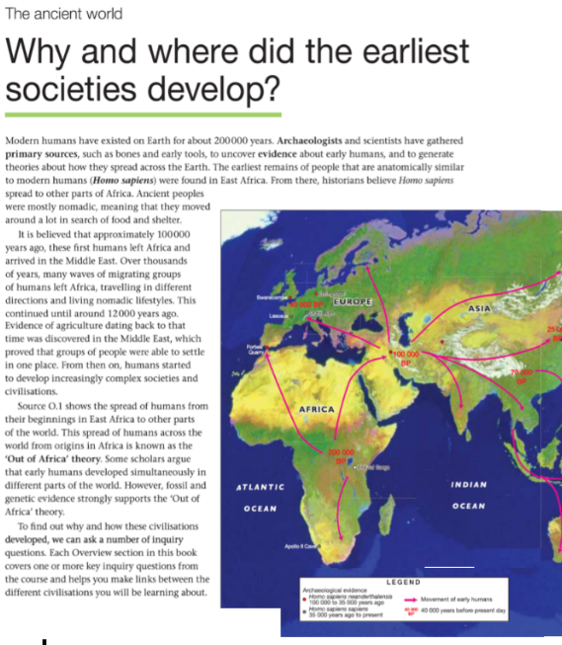
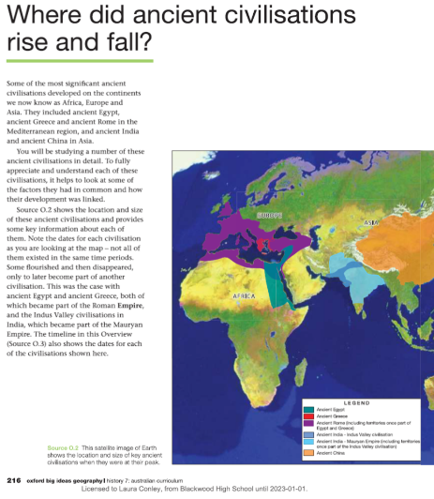
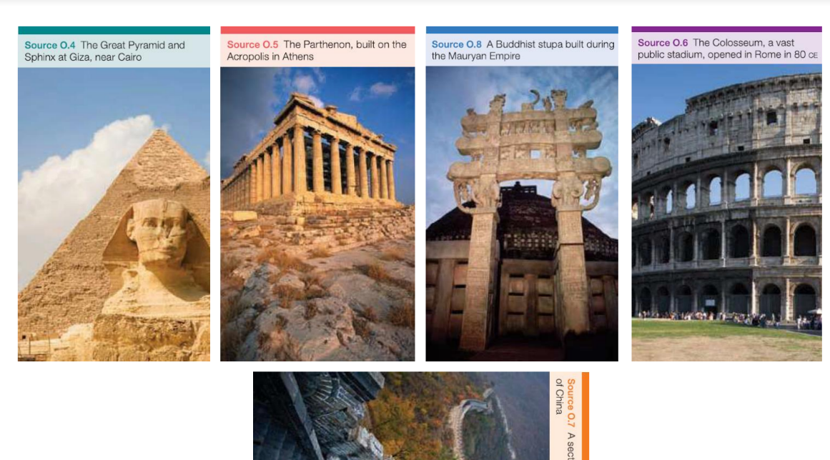
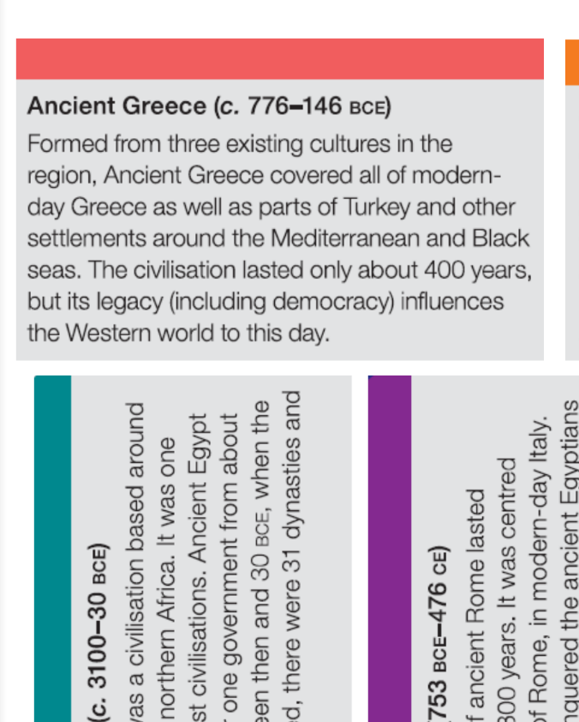
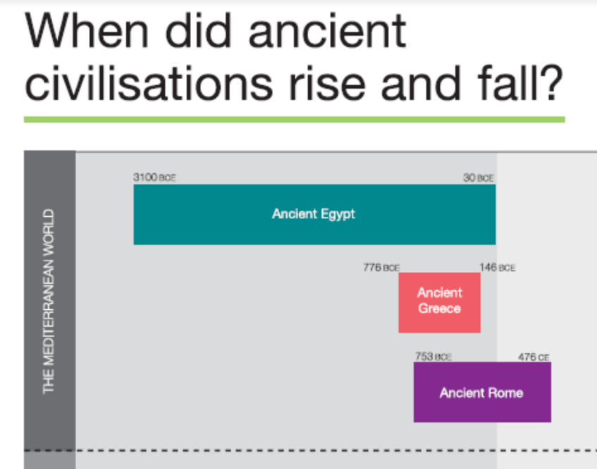
Use the resource pack handed to you or click here for information. As a class we will read the text & unpack any words we don’t understand.
Using Source 0.2, read the coloured ancient regions and see where they were located on the map. Consider what similarities and differences can be drawn from each region based on the given information.
Using the coloured handouts of Ancient Civilisations & Ancient Pictures order and the reorder the ancient civilisations by: a) starting date b) end date c) shortest length of time d) longest length of time
Use When did Ancient Civilisations Rise & Fall to check your orders.
Explain why farming and agriculture were important to the development of civilisations.
Formulate a question that you would like answered to support your understanding of Ancient Civilisations.

Slide 8
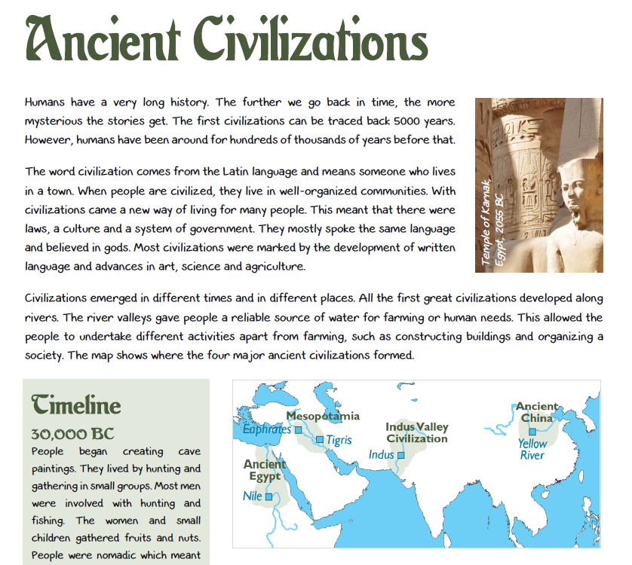
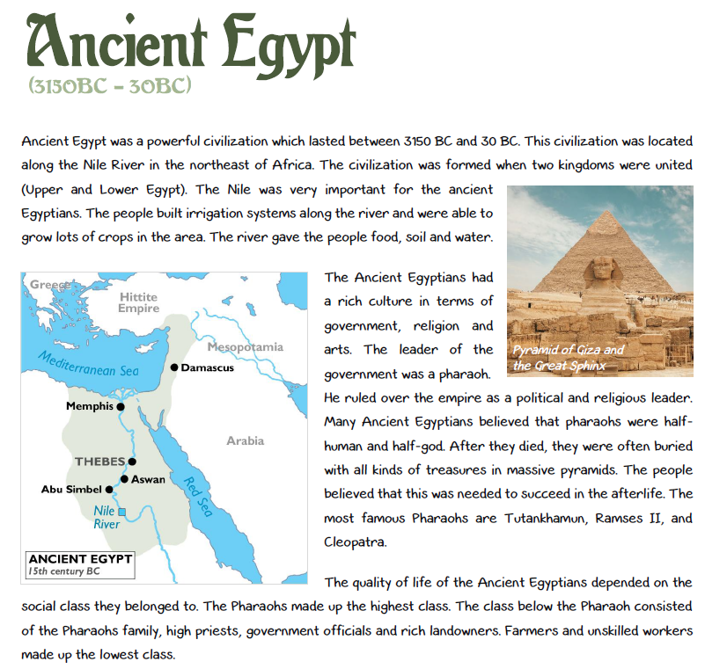
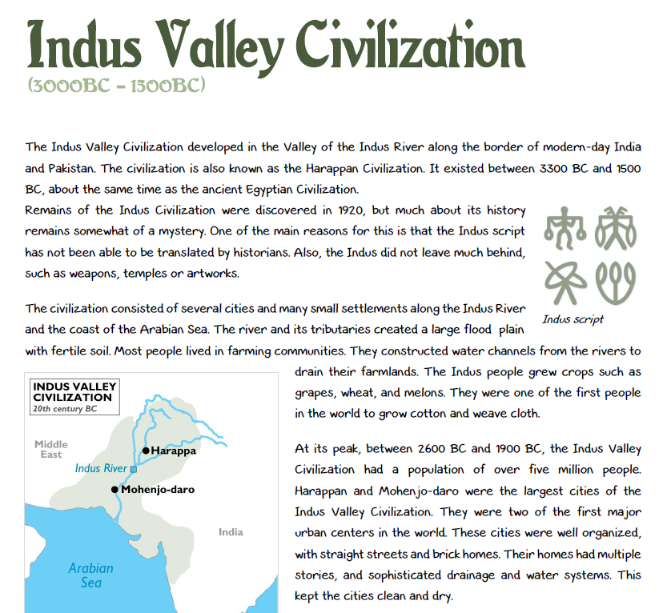
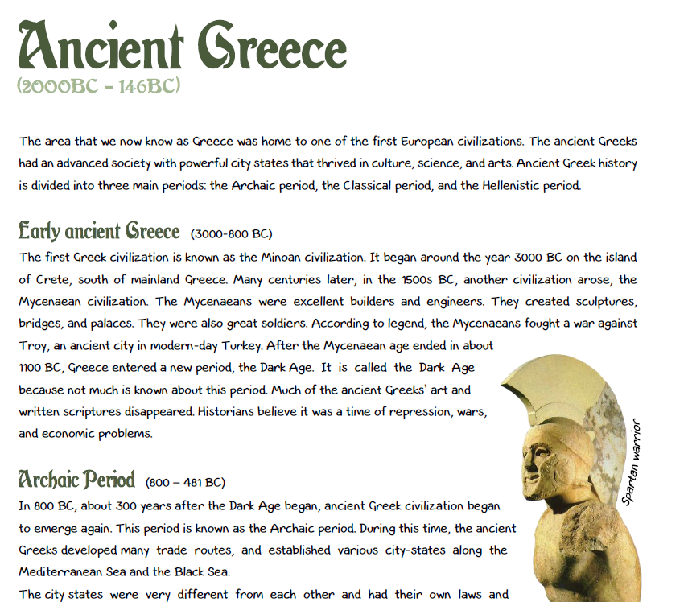
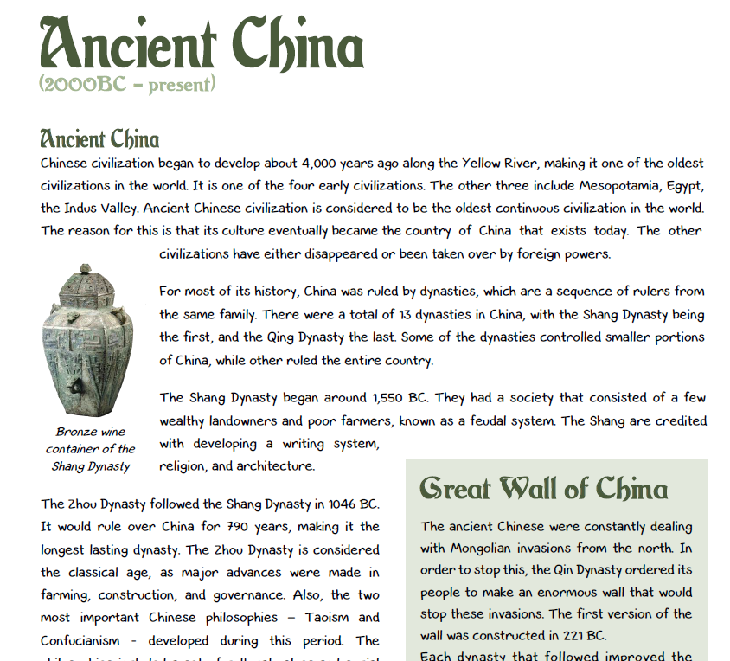
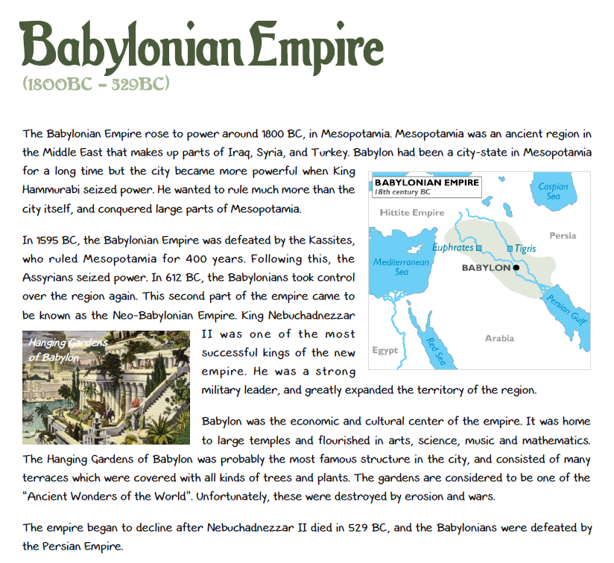
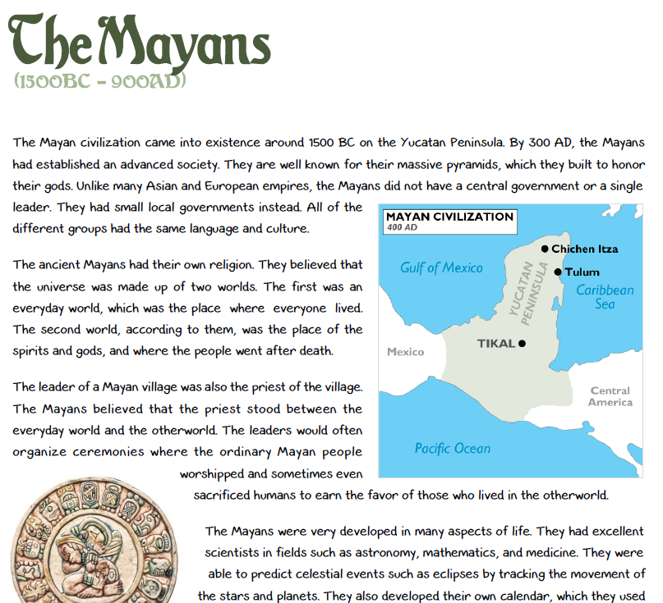
Using the Ancient Civilisations booklet, you will complete page 1 & 2 with a peer in your books.
Then, independently you will choose 1 civilisation of choice from the booklet and complete its activity page.
You will share your findings with your table groups and learn from them about other ancient civilisations.

